Slide 1
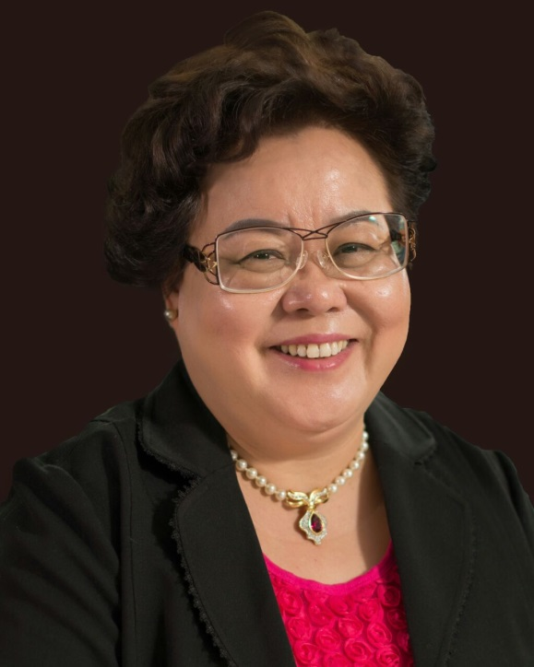
強效的零售攻略
Retailing
Candy Tsang
高級顧問經理級 Director
四個佣金週期共賺取HK$138,000
HK$138,000 in 4 Commission weeks
本簡報中提到的收入等級純屬舉例說明，無意代表美安香港超連鎖店主的一般收入，也無意表示任何超連鎖店主皆可賺取同等收入。美安香港超連鎖店主的成功與否，取決於其在發展事業時的努力、才能與投入程度。The income levels mentioned in the following presentation are for illustration purposes only. They are not intended to represent the income of a typical Market Hong Kong UnFranchise Owner, nor are they intended to represent that any given Independent UnFranchise Owner will earn income in that amount. The success of any Market Hong Kong Independent UnFranchise Owner will depend upon the amount of hard work, talent, and dedication which he or she devotes to building his or her Market Hong Kong Business.

Slide 2
09- 2007 | 加入美安 Joined Market Hong Kong
12-2007 | 經理級 Executive Coordinator
02-2008 | 主管經理級 Master Coordinator
07-2008 | 會議聯盟系統協調員 NMTSS Coordinator
06-2009 | 專業經理級 Professional Coordinator
10-2009 | 顧問經理級 Supervising Coordinator
02-2012 | 總顧問經理級 National Supervising Coordinator
10-2014 | 執行顧問經理級 Executive Supervising Coordinator 高級顧問經理級 Director
香港卓越領袖委員會成員 HK Leadership Council Member 多次成為主管超連鎖店主 Master UFO 曾獲總裁挑戰賽得主 President’s Challenge Winner 授證訓練員 Certified Trainer 演講者機構第二類別成員 Speaker Bureau Category 2
Candy Tsang

Slide 3
我的三個十年 In My Past 30 Years
1987 – 1996
從事製衣行業，從學徒出身，及後有機會開設自己的工場
直至96年，發現連健康都失去，終於決定退休
1987 – 1996
Started my career in the garment industry as an apprentice, years after I had started up my own garment factory .
In 1996, I decided to retire due to health problems

Slide 4
我的三個十年 In My Past 30 Years
1996 – 2006
展開退休生活，滿以為可以重獲健康，但生活頽廢，健康更是每況越下，每月更花費過萬元在醫藥上，決心一試OPC3
1996 – 2006
I thought I could regain my health during retirement life , but my health condition was even worse. I had to spend more than 10 thousand dollar a month for medical care, hence, I determined to try Isotonix® OPC-3.

Slide 5
我的三個十年 In My Past 30 Years
2007至今
因為OPC3，讓自己重拾健康，更成為超連鎖™店主，用心把產品及超連鎖事業帶給更多人
Since 2007
My health was improved significantly with the help of Isotonix OPC-3, and I introduced the mhk products and UnFranchise™ Business to others.

Slide 6
零售技巧 Retailing Skills
－從來沒有把自己當成銷售員
－一心只是想幫助朋友解決健康問題
－就是真誠關心別人，幫助別人
－不是每個個案都成功，有時也會遇挫折
－作出檢討，改善自己的技巧
- Never put myself as a salesperson
- Try to help others to solve health problems
- Care for and help others sincerely
- Not all cases are successful
- Review and improve my own skills

Slide 7
零售技巧 Retailing Skills
多聆聽，了解對方需要
過份熱情，會惹來反感
Listen and understand people’s needs
Don’t be over passionate

Slide 8
零售技巧 Retailing Skills
多聆聽，了解對方需要
過份熱情，會惹來反感
增進產品知識
多上產品訓練，溫故知新
Listen and understand people’s needs. Don’t be over passionate
Improve product knowledge, participate in product trainings to refresh my mind

Slide 9
零售技巧 Retailing Skills
多聆聽，了解對方需要
過份熱情，會惹來反感
增進產品知識
多上產品訓練，溫故知新
提供售後服務，注重跟進
與顧客建立深厚關係
Listen and understand people’s needs. Don’t be over passionate
Improve product knowledge, participate in product trainings to refresh my mind
Provide after-sales service, pay attention to the follow-up action and build strong relationships with customers

Slide 10
總結Summary
一定要自己去試用產品，透過分享產品的好處促成零售
從一件產品開始，然後再介紹更多產品給顧客，直至把整個Shop.com介紹給他們
Be sure to try the products yourselves, so that you can share sharing the benefits of the products
Start from a product, and then introduce more products to customers, and Shop.com

Slide 11
我的三個十年 My Past 30 Years

